Slide 1


GROUP 5 MEMBERS
OKIDI NORBERT S23B23/051
BUWEMBO DAVID DENZEL S23B23/074
KIISA ANGELA GRACE S23B23/027
NZIRIGA ISAAC NICKSON S23B23/046
KISUZE GARETH NEVILLE S23B23/029
NAJJUMA TEOPISTA S23B23/041

Slide 2


Online Shopping Cart System
This project presents an Object-Oriented Programming (OOP) implementation of an Online Shopping Cart System in Python. It simulates a basic e-commerce experience, allowing customers to browse products, add items to their cart, create orders, and process payments.
nn

Slide 3
Core Classes
1
Product
2
Customer
Manages product details like ID, name, price, and stock.
Handles customer information like customer id, name, etc.
3
Cart
4
Order
Manages shopping cart operations and calculations.
Processes orders with unique IDs and totals.

Slide 4


Encapsulation
Data Protection
Private attributes control access to sensitive data.
Controlled Access
Methods provide secure ways to interact with object data.
Consistency
Ensures data integrity across the system.

Slide 5
Abstraction
1
Simplified Interface
Complex operations are hidden behind simple methods.
2
User-Friendly
Customers interact with the system without understanding backend complexities.
3
Maintainability
Easier to update and modify internal workings without affecting user experience.

Slide 6


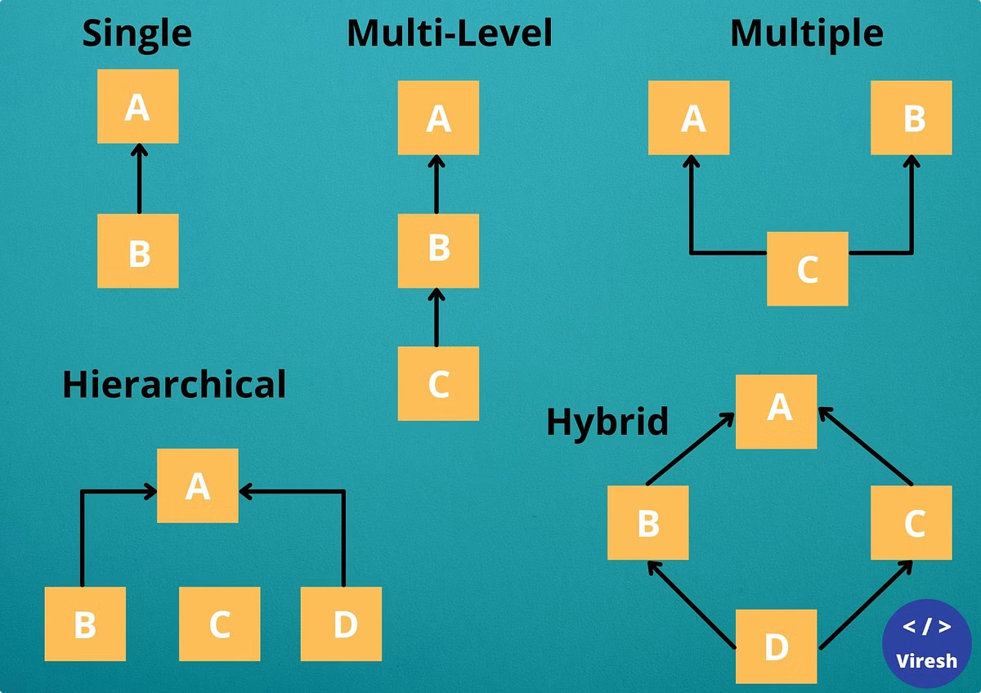


Inheritance
Base Classes
Payment serve as foundational class.
Derived Classes
Specific payment types inherits from Payment.
Code Reuse
Shared attributes and methods reduce redundancy.

Slide 7
Polymorphism
Payment Processing
Flexibility
Consistency
Different payment methods use the same process_payment interface.
New payment types can be easily added without changing core system.
Uniform method calls across various payment types.

Slide 8

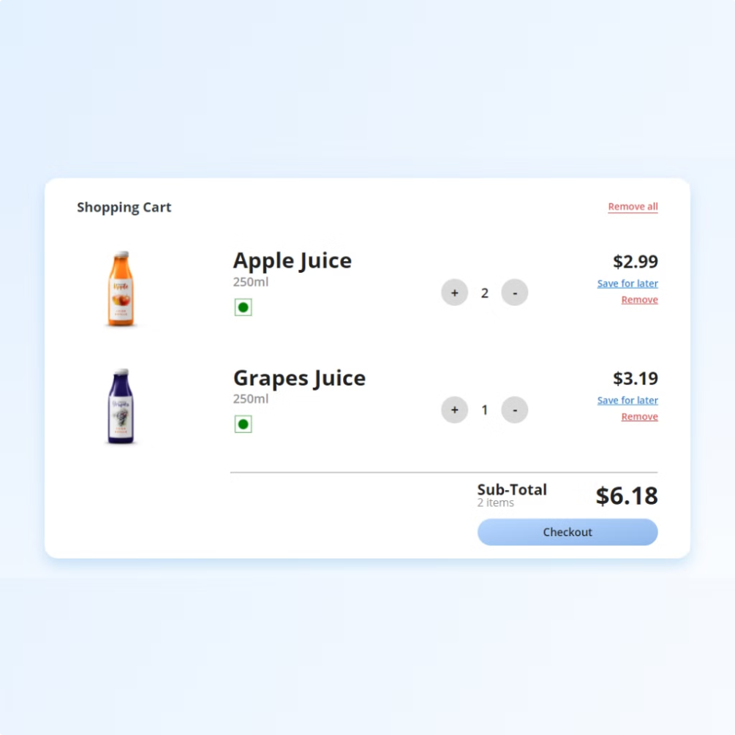
Cart Functionality
1
Add Products
Users can add items to their cart.
2
View Contents
Cart contents and totals are easily accessible.
3
Modify Quantities
Users can adjust item quantities or remove products.
4
Calculate Total
Cart automatically calculates the total cost.

Slide 9
Order Processing
Unique IDs
Total Calculation
Status Tracking
Each order is assigned a unique identifier.
Order total is computed based on cart contents.
Order status can be monitored throughout the process.

Slide 10

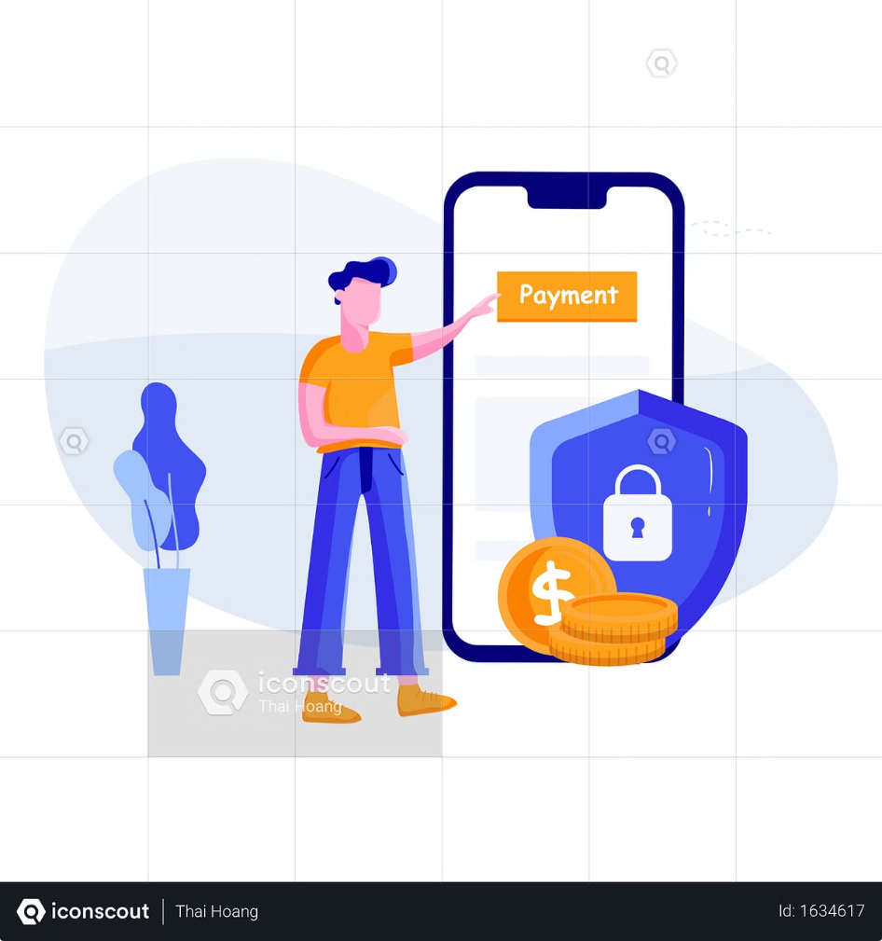



Payment Handling
Credit Card
Processes credit card payments securely.
PayPal
Handles PayPal transactions efficiently.
Extensible
System can be expanded to include more payment methods.

Slide 11
Future Enhancements
1
Discounts
Implement a system for applying discounts and promotions.
2
Database Integration
Add persistent storage for products, customers, and orders.
3
User Authentication
Implement secure login and role-based access control.
4
Analytics
Add reporting features for business insights and decision-making.

Slide 12
THANK YOU!

